Slide 1
Machine Learning In PRACTICE - Introduction
Przemysław Sekuła

Slide 2
Bias-Variance DILEMMA
In statistics and machine learning, the bias–variance tradeoff (or dilemma) is the problem of simultaneously minimizing two sources of error that prevent supervised learning algorithms from generalizing beyond their training set
The bias is an error from erroneous assumptions in the learning algorithm. High bias can cause an algorithm to miss the relevant relations between features and target outputs (underfitting).
The variance is an error from sensitivity to small fluctuations in the training set. High variance can cause an algorithm to model the random noise in the training data, rather than the intended outputs (overfitting).

Slide 3
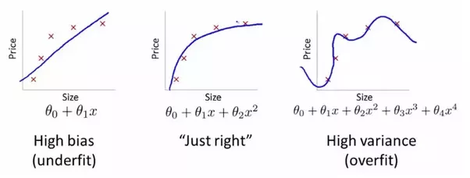
Bias and Variance - Regression

Slide 4
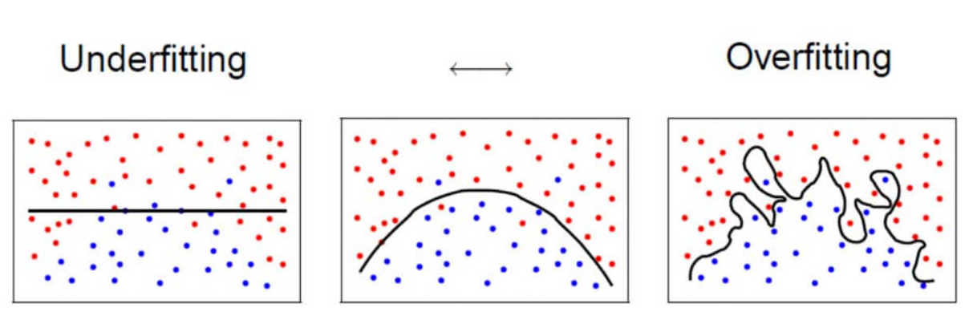
Bias and Variance - Classification

Slide 5
What does it mean?
In case of bias (underfitting), our model cannot capture the complexity of the data. In result we have a big, avoidable error.
In case of variance (overfitting) our model is too complicated. So for the training dataset we do not have an error, but our model cannot generalize (works poorly with earlier unseen data).

Slide 6
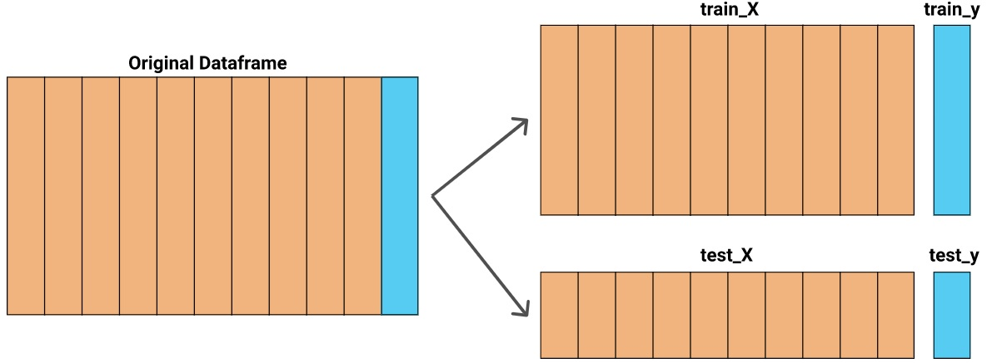
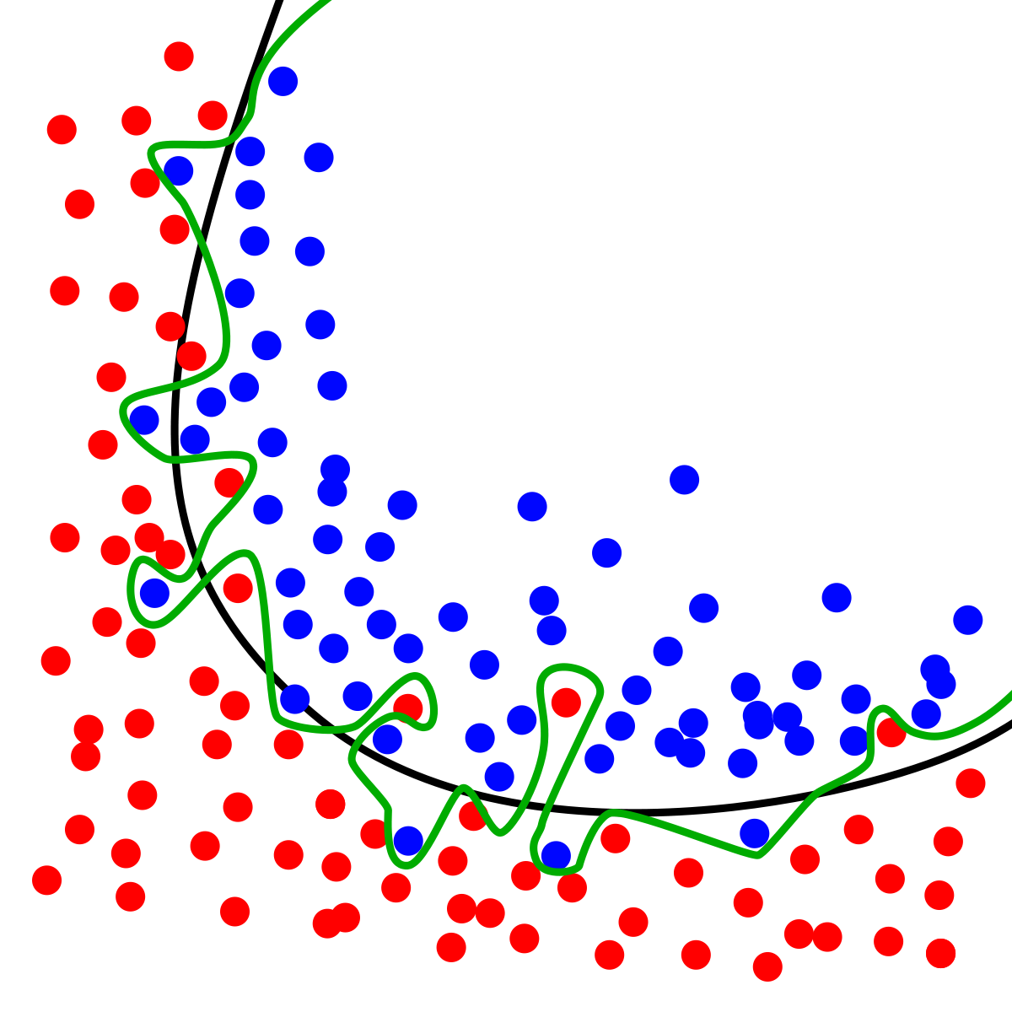
How to solve the problem? (1/3)
First of all, you need to know, if you have the problem. The rule of the thumb is:
You have a bias problem, if the results for training dataset look poor (have a big error)
To check the variance, you should split your dataset into train and test part. You should use only the train data, for training your model. Then you may assess your model (accuracy, R², MAPE, etc.) on the test data. If your model works well for train data, but fails for test data, you probably suffer from overfitting

Slide 7

HOW TO SOLVE A PROBLEM (1/3)
Example 1
You are solving the cat-dog problem (assess if we have a cat or a dog on the image). The so-called human level error is 0.5%. Your results are:
For train dataset: Accuracy 92% (8% error)
For test dataset: Accuracy 91.5% (8.5% error)
Question: Bias or Variance?

Slide 8
HOW TO SOLVE A PROBLEM (1/3)
Example 2
You are solving the cat-dog problem (assess if we have a cat or a dog on the image). The so-called human level error is 0.5%. Your results are:
For train dataset: Accuracy 99.6% (0.4% error)
For test dataset: Accuracy 89% (11% error)
Question: Bias or Variance?

Slide 9
HOW TO SOLVE A PROBLEM (1/3)
Example 3
You are solving the cat-dog problem (assess if we have a cat or a dog on the image). The so-called human level error is 0.5%. Your results are:
For train dataset: Accuracy 99.6% (0.4% error)
For test dataset: Accuracy 99.5% (0.5% error)
Question: Bias or Variance?

Slide 10
How to solve a problem (2/3)
If you have too high variance, you may use one of the following reasoning:
Your model is too complicated
Your model memorizes data (instead of generalization)
The most obvious solutions are:
Get more data!
Create less complicated model
Reduce the number of features (it also makes your model simpler)
Use regularization (we will cover it in the next classes)

Slide 11
How to solve a problem (3/3)
If you have too high bias, you may use one of the following reasoning:
Your model is too simple (it cannot capture the complexity of the data)
You overuse the regularization
The most obvious solutions are:
Create more complicated model
Use less regularization (or get rid of it).

Slide 12
Bias Variance SUMMARY
You should always use Train and Test sets, to know if you have a bias-variance problem
Note – in fact we usually used 3 sets (Train / Dev / Test), and sometimes even more. Will cover it in next classes
High Variance = Overfitting
High Bias = Underfitting
If you suffer from high variance get more data or reduce the complexity of the model.
If you suffer from high bias increase the complexity of the model
Regularization is a set of techniques that help us dealing with bias-variance problem
To solve bias-variance problem you need to experiment

Slide 13
Data ANALYSIS AND Preparation
Analyze
Modify
Train
Test
Machine Learning is simple!
It is very easy to implement the algorithm when you use frameworks
The training is also very easy, but it may be time-consuming
The difficult parts associated with machine learning are
Data analysis and preparation
Testing and adjusting your model
You should always take a look at your data in the beginning. It will save a lot of your time later.
… But do not spend too long just looking at the data. Machine learning is an iterative process!

Slide 14
Thank you Q & A

